Slide 1
LinguaLearn Project
An Online Language Teaching Application Utilizing OOP Concepts

Slide 2

Introduction
This presentation outlines the LinguaLearn project, which leverages object-oriented programming concepts to create an effective online language learning platform.

Slide 3
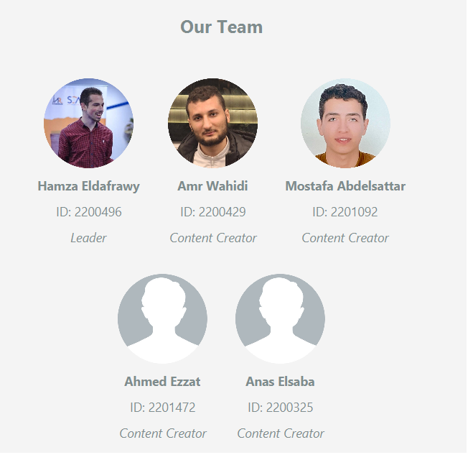

Slide 4
01
Lingualearn In Big Picture

Slide 5
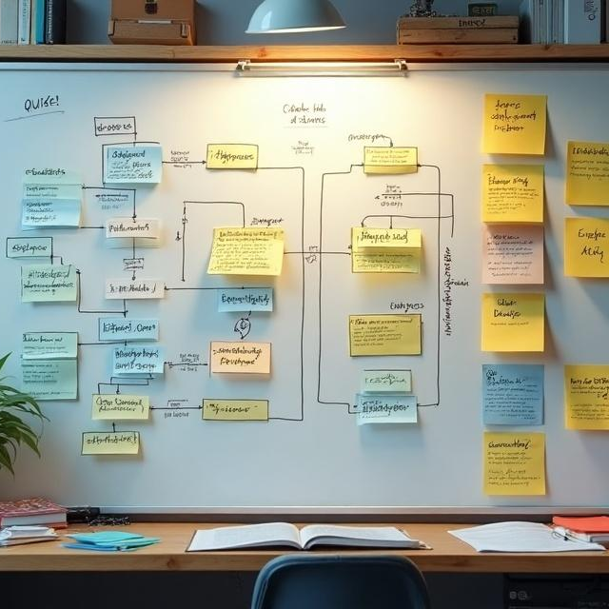
UML Design
The LinguaLearn application utilizes classes to represent various entities such as users, lessons, and quizzes. Each class encapsulates attributes and methods relevant to its functionality, allowing for organized and efficient code management.

Slide 6
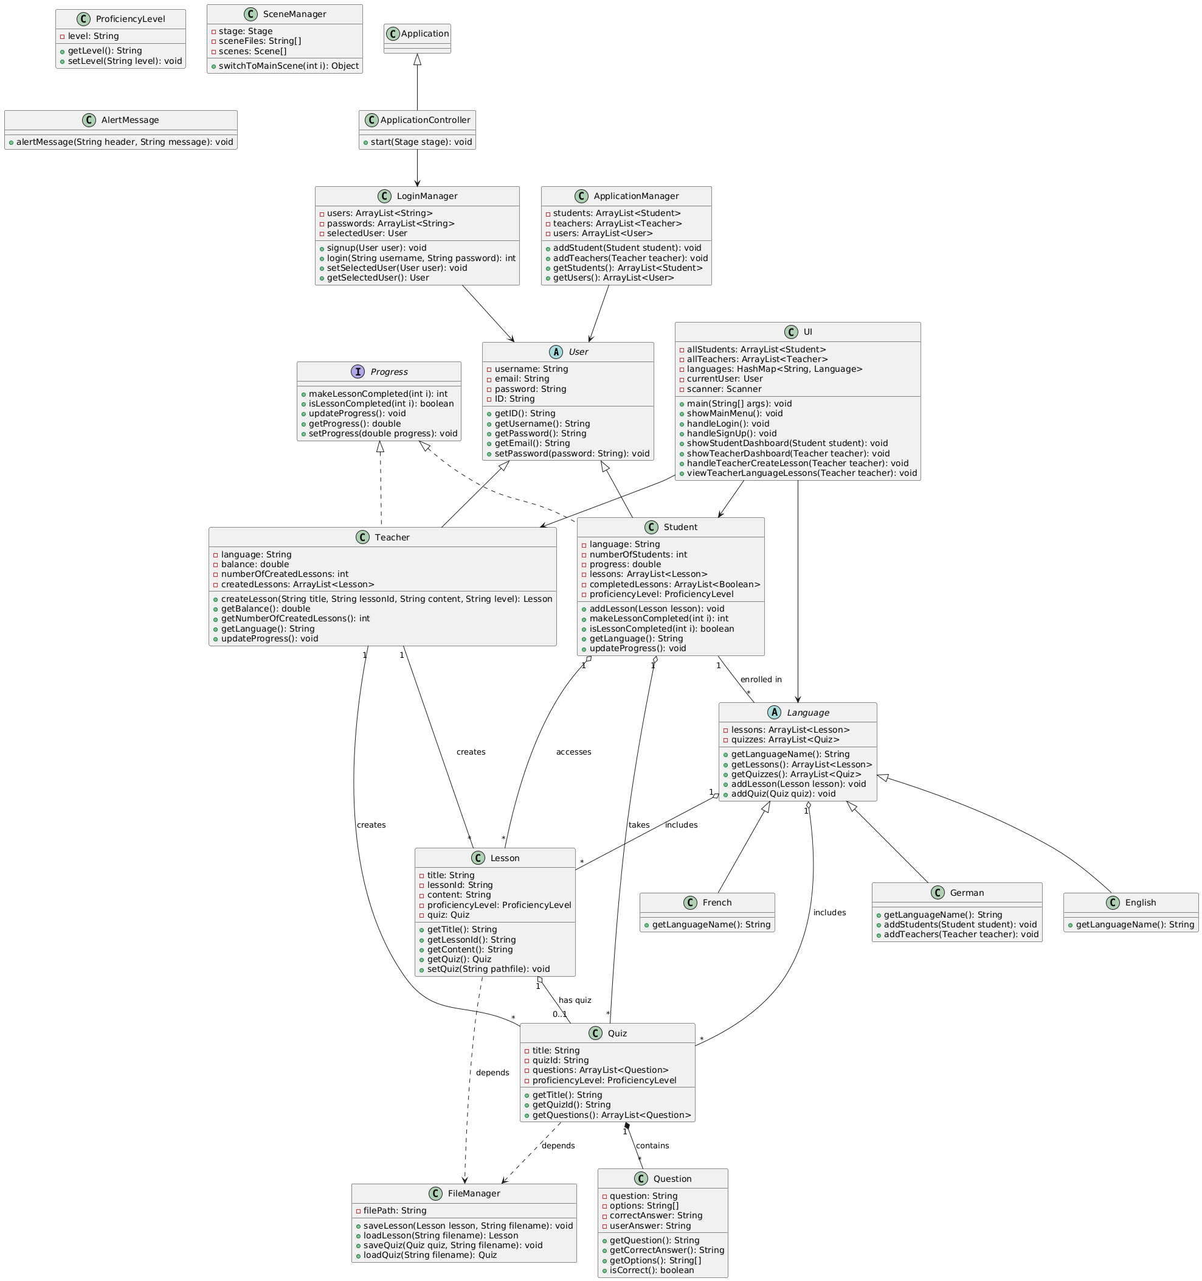

Slide 7
UML Division

Slide 8
Key features
LinguaLearn includes several key features that enhance the learning experience. These include interactive lessons, progress tracking, interacticve quizzes to engage users effectively

Slide 9
Contributions
Name | Contribution
Amr Ahmed Wahidi | UI, Quiz, Lesson, Question
Hamza Basem Mohamed Ahmed Eldafrawy | Language, German, French, English
Anas Ayman Mohammed Elsayed | GUI style, Scene Manager, exception handling
Ahmed Ezzat Ebrahim | GUI styling , controller development, handling polytheism
Mostafa Ahmed Abd El Sattar | User, Student, Teacher, ProficiencyLevel

Slide 10
02
OOP Concepts Implemented

Slide 11
Encapsulation Techniques
Encapsulation is implemented by restricting direct access to the object's data. This practice ensures data integrity by allowing interaction through public methods, promoting a clear interface for the educational functionalities offered by LinguaLearn.

Slide 12
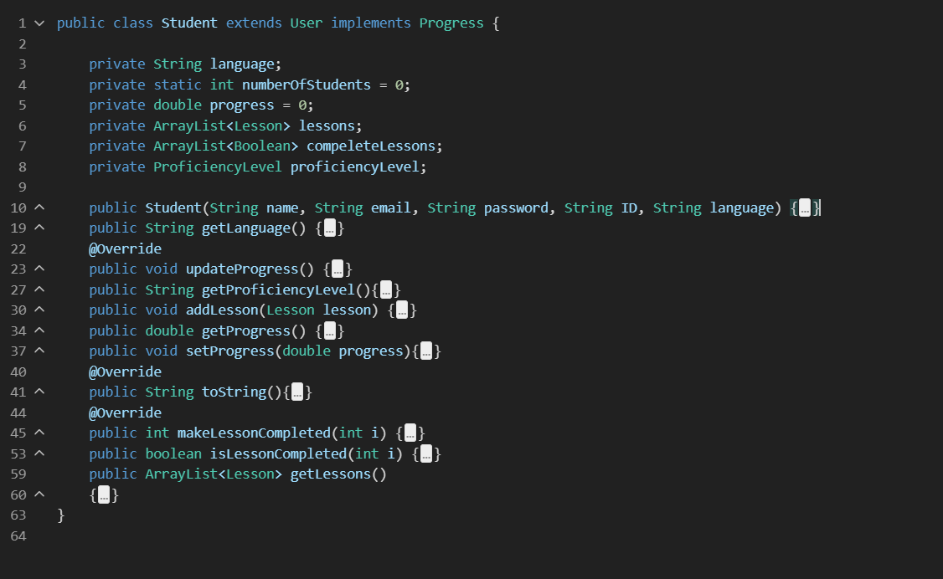
Encapsulation Example 1

Slide 13
Encapsulation Example 2

Slide 14
Inheritance and Polymorphism
Inheritance is employed to create specialized classes for different language courses, enabling code reusability. Polymorphism allows methods to be overridden in derived classes, providing flexibility in how lessons are presented based on user needs.

Slide 15






Polymorphism Example 1

Slide 16
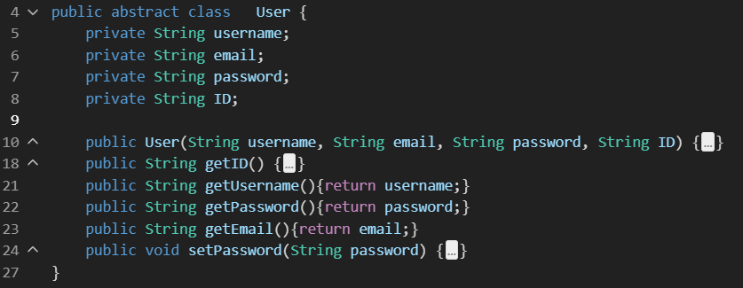
Polymorphism Example

Slide 17
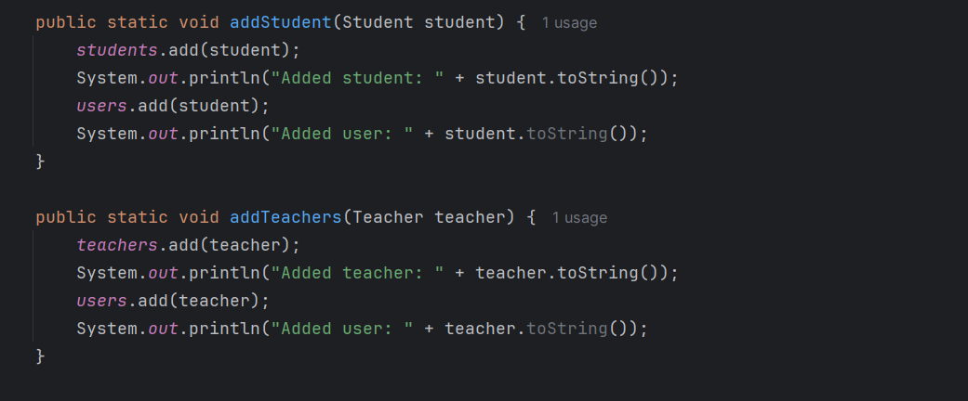
Polymorphism Example

Slide 18
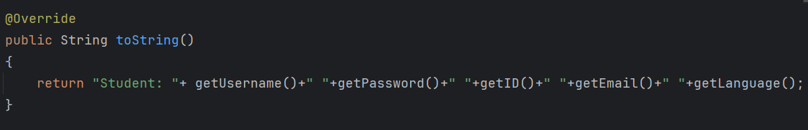
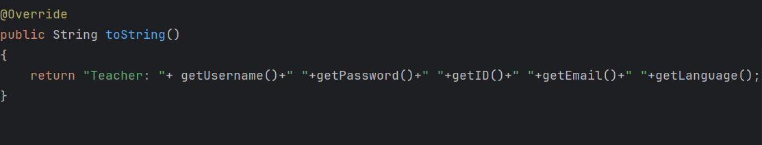
Polymorphism Example

Slide 19
Polymorphism Example 2

Slide 20
Generic Sorting
A generic sort is a flexible, reusable way to sort any list of objects using Java's built-in sorting tools (Collections.sort, List.sort) combined with Comparable or Comparator interfaces.

Slide 21
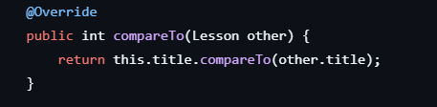
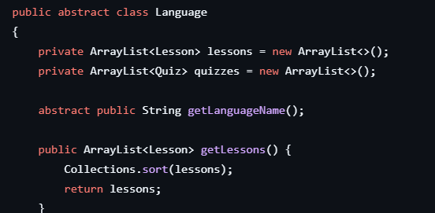
Generic Sort Example

Slide 22
Exception Handling
LinguaLearn includes several key features that enhance the learning experience. These include interactive lessons, progress tracking, interacticve quizzes to engage users effectively.

Slide 23
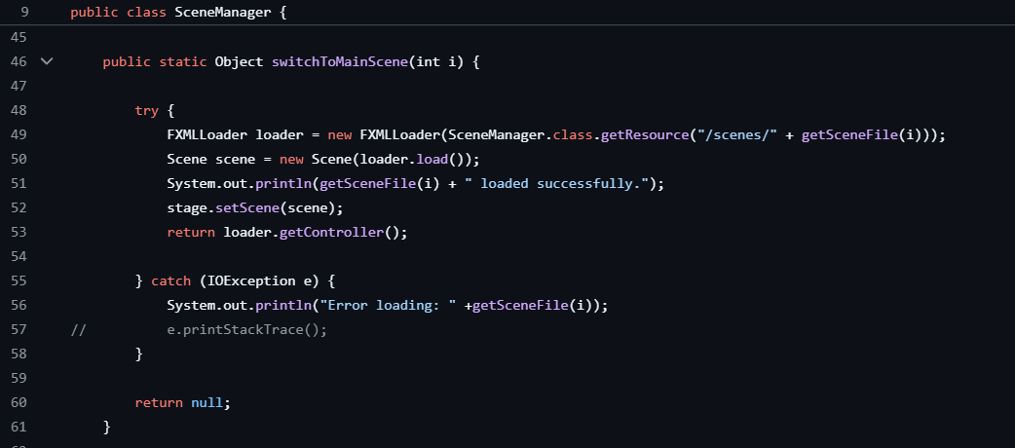
Exception Handling Example 1

Slide 24
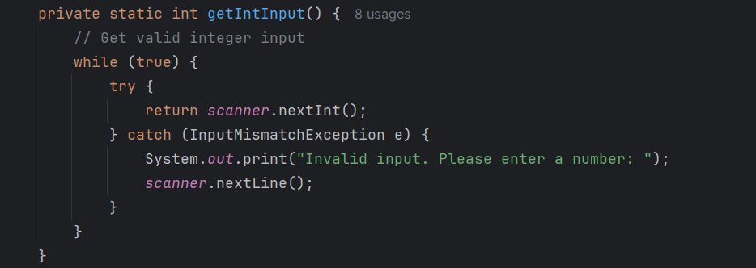
Exception Handling Example 2

Slide 25

Unit Testing

Slide 26
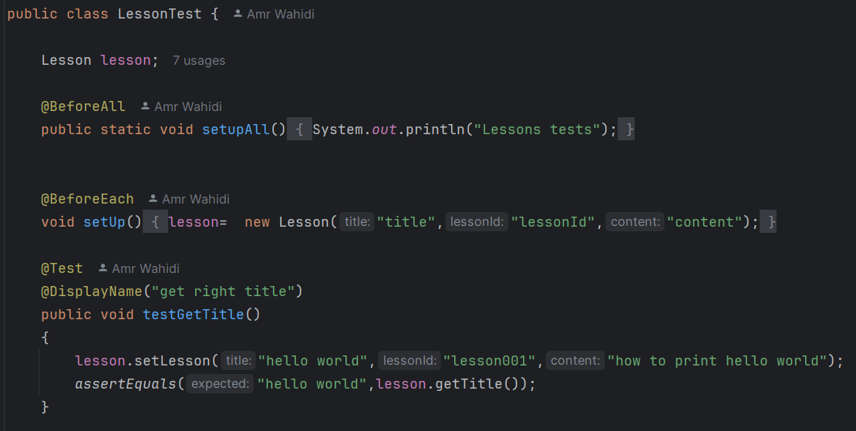
Testing Lesson Class

Slide 27
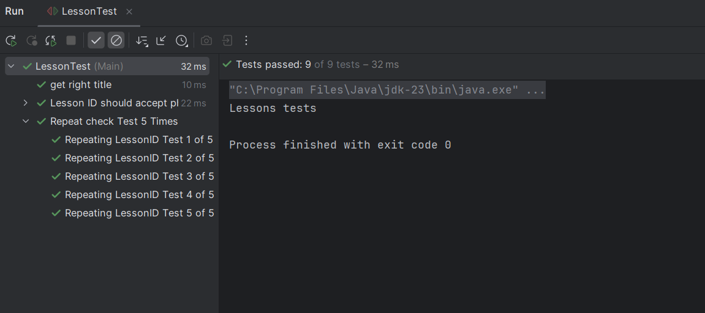
Testing Lesson Class

Slide 28
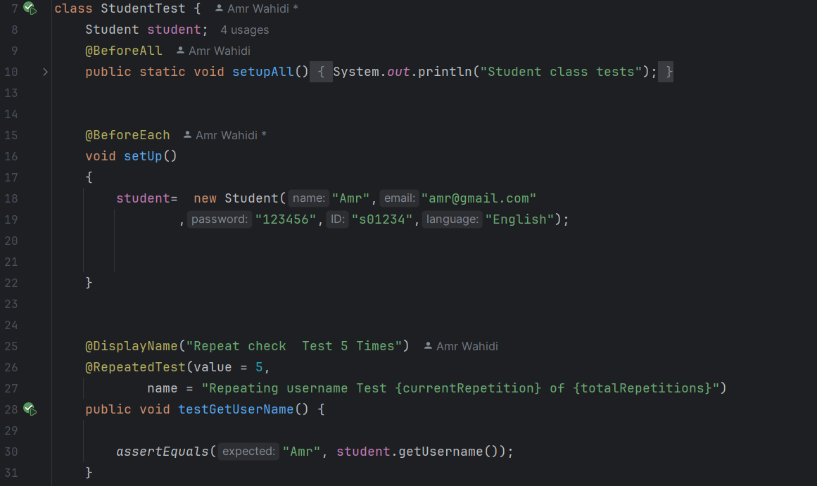
Testing Student Class

Slide 29
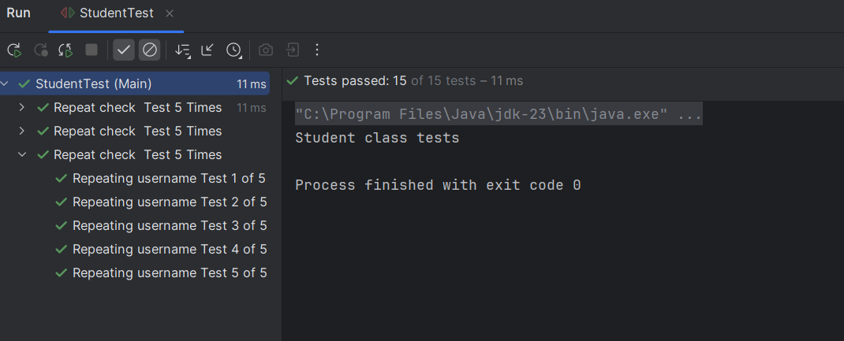
Testing Lesson Class

Slide 30
UI of Lingualeran
For testing and Debugging
UI is the part of LinguaLearn that users interact with — including everything you see and touch in an application — like screens, buttons, icons, text, and layout.

Slide 31
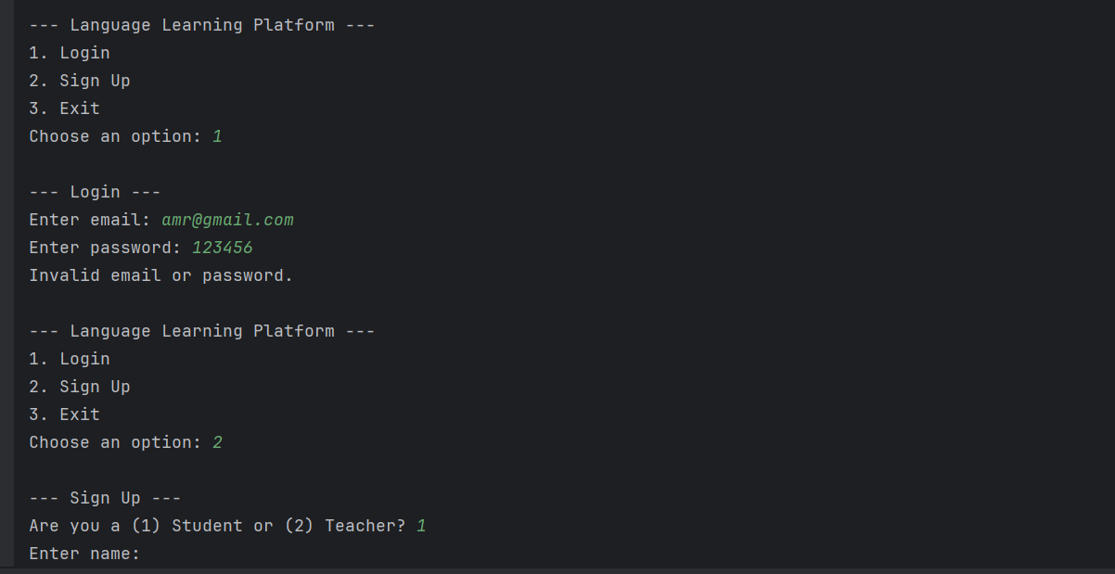
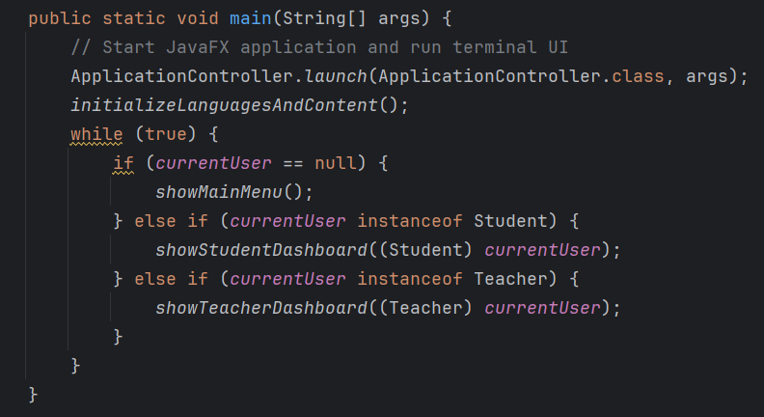
UI Input/Outputs Using Terminal

Slide 32
Let’s Run a Demo of LinguaLearn UI

Slide 33
GUI of LinguaLearn
GUI is the visual part of LinguaLearn that users interact with — using graphics like buttons, windows, icons, menus, and text fields instead of typing commands.

Slide 34
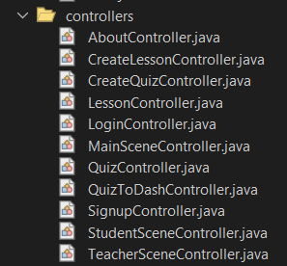
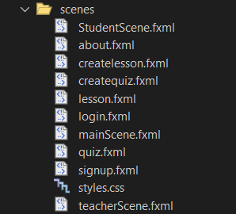
Scenes / Controllers Overview
Controllers are the logic handlers for scenes or views. They contain methods that connect the UI with the Backend (Model).
Scenes represent the content displayed on a window or stage. They contain UI elements like buttons, text fields, labels, etc.

Slide 35
Let’s Run a Demo of LinguaLearn GUI

Slide 36

GitHub Repo

Slide 37
Thank you!
Do you have any questions?

